Slide 1
The Female reproductive System: Follicle Development and The Hormones Involved
Student’s Name
Institution of Affiliation
Course Code and Name
Professor
Date

Slide 2
Female Monthly Cycle: Introduction
AKA Menstrual cycle
Definition – cyclic events that take place in a rhythmic fashion during the reproductive period of a woman’s life (Sembulingam & Sembulingam, 2012).
Onset; AKA Menarche– during puberty - age of 12 to 15 years
Cessation – age of 45 to 50 years
Permanent cessation; AKA Menopause
Duration – usually 28 days; under physiological conditions, it may vary between 20 and 40 days (Hall, & Hall, 2010).
Changes: in both the ovary and accessory sex organs
Divided into 4 groups:
Ovarian changes
Uterine changes
Vaginal changes
Change in cervix (Hall, & Hall, 2010).

Slide 3
1. Ovarian Changes
Two Phases:
Follicular phase
Luteal phase
Ovulation separates these two phases
Follicular Phase
Extends from 5th day of the cycle until the time of ovulation around the 14th day (Hall, & Hall, 2010).
(NB: The first day of the cycle is the first day of flow of menses)
Main changes:
Maturation of ovum
Development of ovarian follicles (Sembulingam & Sembulingam, 2012).

Slide 4
Ovarian Follicles
Are glandular structures present in the cortex of ovary
Each follicle has an ovum surrounded by epithelial cells, the so called granulosa cell
Different follicles: depict the stages of development of the follicle
Primordial follicle
Primary follicle
Vesicular follicle
Matured follicle or Graafian follicle
Hormone implicated in the development of follicle – Follicle Stimulating Hormone (FSH)
Luteinizing Hormone (LH) remains low during the development of the follicle and only becomes elevated towards ovulation – LH Surge (Sembulingam & Sembulingam, 2012).

Slide 5
Hormones Levels changes during The Cycle
Regulation of follicle development is by local paracrine and systemic endocrine factors (Kawashima & Kawamura, 2017)
Endocrine factors: Hormones
Systemic: Pituitary hormones
Luteinizing Hormone (LH) and Follicle Stimulating Hormone (FSH)
Released by the Anterior Pituitary gland
Under negative feedback control by the release of estrogen and progesterone
Paracrine: Ovarian or sex Hormones
Estrogen and Progesterone
Under negative feedback control by the release of the two pituitary hormones (Sembulingam & Sembulingam, 2012).
Notes:
Systemic to imply secreted into blood and transported to act on targets on a different part of the body
Paracrine to imply secreted by a cell to act on neighboring cells.

Slide 6
Stages of Follicle Development and the Hormones that come to play
Primordial Follicle (PF)
Develops before birth
Present at puberty with each both ovaries having about 400,000 PF
Recruited into follicle development by both FSH and LH and begins to grow slowly through various stages
Release of FSH and LH begins at puberty
Release of FSH and LH is stimulated by the low levels of both estrogen and progesterone (Sembulingam & Sembulingam, 2012).

Slide 7
Stages of Follicle Development and the Hormones that come to play
2. Primary Follicle (PrF)
Develops from the PF once the ovum is completely surrounded by the granulosa cells
Growth is in size
Changes:
Proliferation of granulosa cell leads to
Increase in size of the follicle to 30 to 40 microns
Increase in size of the Ovum to about 20 microns
Onset of formation of connective tissue capsule around the follicle
Hormones:
FSH
Notes:
Remember LH levels still remain low at this stage
Stage under influence of FSH

Slide 8
Stages of Follicle Development and the Hormones that come to play
3. Vesicular Follicle (VF)
Develops from PrF
Under influence of FSH
About 6 to 12 PrF grow and develop into vesicular follicle
Changes:
1. In granulosa cells:
Proliferation
Formation of the antrum filled with serous fluid, liquor folliculi
Granulosa cells lining the antrum forms membrane granulosa
Ovum is pushed to one side forming the germ hill or cumulus oophorous
Cells of germ hill become columnar and form corona radiata
(Sembulingam & Sembulingam, 2012).
Notes:
Remember LH levels still remain low at this stage
Stage under influence of FSH

Slide 9
Stages of Follicle Development and the Hormones that come to play
Changes (cont.)
2. In the ovum
Increase in size to 100 to 150 microns in diameter
Nucleus – larger and vesicular
Cytoplasm – glandular
Thick membrane formed around the ovum – zona pellucida
Narrow cleft appears between the ovum and zona pellucida - perivitelline space
3. Formation of capsule
By spindle cells of the stroma of ovarian cortex
Modified and form a covering sheath around the follicle – Follicular sheath or Theca folliculi
(Sembulingam & Sembulingam, 2012)
Notes:
Remember LH levels still remain low at this stage
Stage under influence of FSH

Slide 10
Stages of Follicle Development and the Hormones that come to play
Follicular sheath or theca folliculi
Two layers:
Theca interna
Inner vascular layer with loose connective tissue
Some epithelial cells with lipid granules
Some delicate collagen fibers
Secretory epithelial cells – sex hormones: especially estrogen into the liquor folliculi
Estrogen release – negative feedback to pituitary gland – reduction in FSH
(Sembulingam & Sembulingam, 2012).

Slide 11
Stages of Follicle Development and the Hormones that come to play
b) Theca externa
Outer layer
With thickly packed fibers and spindle-shaped cells
4. Graafian Follicle (GF)
Is the matured ovarian follicle
With maturing ovum
Named after the Dutch physician and anatomist, Regnier De Graaf
About 7th day of menstrual cycle
Develops from only ONE of the VF that outgrows others to become the dominant follicle
Other VF degenerate, that is, become atretic
Mechanism – by apoptosis (Sembulingam & Sembulingam, 2012).

Slide 12
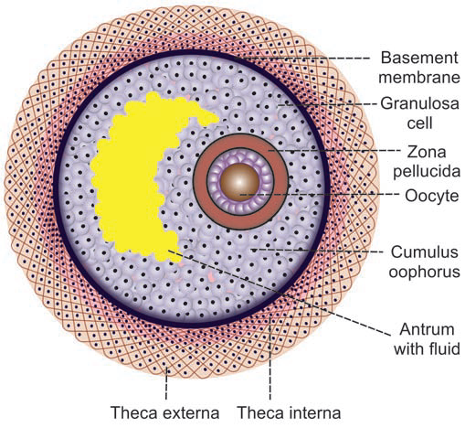
Graafian Follicle (GF)
Notes:
Image courtesy of Sembulingam & Sembulingam, 2012.

Slide 13
4. Graafian Follicle (cont’d)
Changes:
Size – increases to about 10-20 mm, extending through the whole thickness of ovarian cortex
Antrum – becomes larger, distended with fluid
Ovum – attains maximum size
Thickened Zona pellucida
Prominent Corona radiata (CR) and Theca Interna
Space appears in the CR separating the germ hill cells from the ovum; weakens the attachment of the ovum to the follicular wall
Fully formed around the 14th day of the menstrual cycle, ready for the process of ovulation
Hormones
Reducing levels of FSH due to negative feedback effect of the continued release of the sex hormones, (especially estrogen) by the cells of the theca interna (Sembulingam & Sembulingam, 2012)

Slide 14
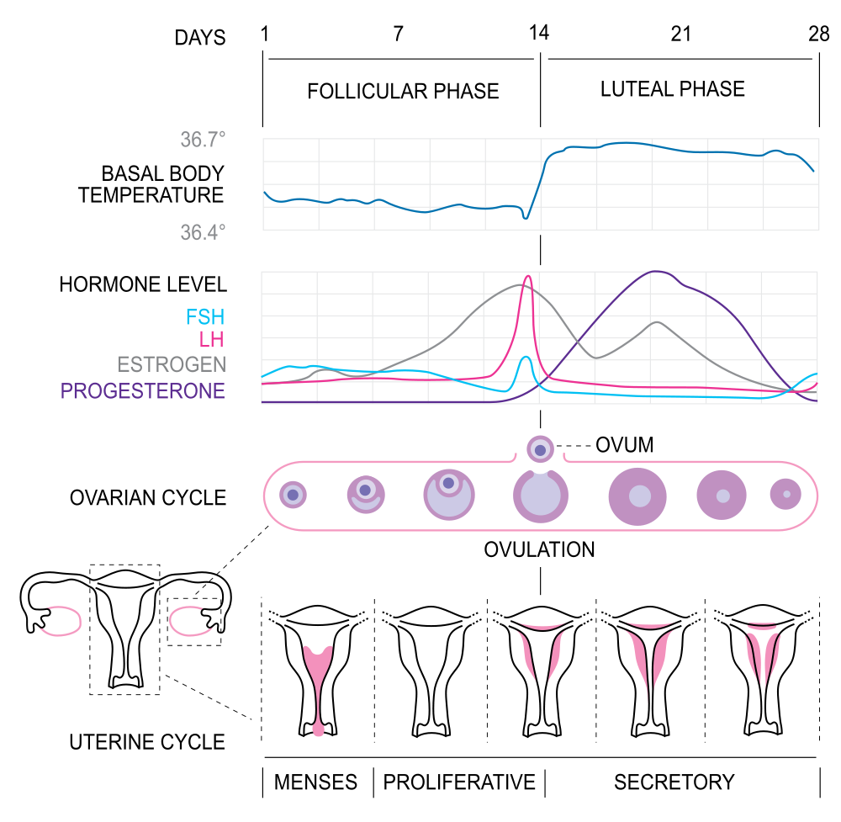
Summary of the Levels of the Hormones during the Development of the Follicle
Notes:
Image courtesy of Lumen. Retrieved from https://courses.lumenlearning.com/boundless-ap/chapter/physiology-of-the-female-reproductive-system/

Slide 15
References
Hall, J. & Hall, J. (2010). Guyton and Hall Textbook of Medical Physiology. Saunders Elsevier
Kawashima, I. & Kawamura, K. (2017). Regulation of Follicle Growth through Hormonal Factors and Mechanical Cues mediated by Hippo Signaling Pathway. Systems Biology in Reproductive Medicine, 68(1): 3-11
Sembulingam, K. & Sembulingam, P. (2012). Essentials of Medical Physiology. 6th Edition. New Delhi: Jaypee Brothers Medical Publishers (P) LTD

